Slide 1

Programming 101
Programming for non-programmers.
You will need Python 2.7.13
Go to https://www.python.org/downloads/
Click , download it and install it.

Slide 2
Objectives
You will be able to:
Read (and write) code
Understand the basic building blocks of a program
Display information to users (output)
Name different data types and say some differences between them
Store data provided by users (input)
Get the computer to write a story based on information you give it

Slide 3
4 Things To Bear In Mind
Programming is more of a skill than a subject.
Even if you memorise all the books, your first driving lesson isn’t going to be perfect.
Reading code is easier if you read right to left.
Think ‘6 = 3 + 3’ rather than ‘3 + 3 = 6’.
Mistakes are useful.
The more you make, the more you learn.
I’m going to show you more than you need to know.
It may not seem important, but it will help you find problems later.

Slide 4
Participation
Feedback is useful
Stop me if you get confused.
This is not a classroom
If you need to leave, that’s obviously OK.

Slide 5
Natural Language and Formal Language
Question:
How is spoken language different to a programming language?

Slide 6
Natural Language and Formal Language
Question:
How is spoken language different to a programming language?
Natural language can be structured or unstructured:
“I’m going to the park later; are you coming?”
“Park. Later. Coming?”
Formal languages, like mathematics and Python have rules.
3 + 3 = 6 is syntactically correct. 3 3 += 6 is not.
name = ‘Drew’ is syntactically correct. Put Drew in name is not.
The words and symbols have to be in the right order.

Slide 7
What can computers do?
Question:
What are the basic building blocks of a computer program?
What can you actually ask computers to do?

Slide 8
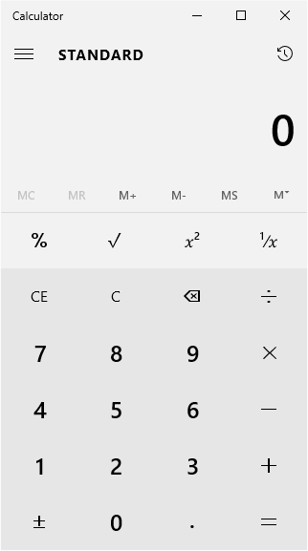
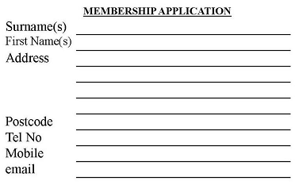
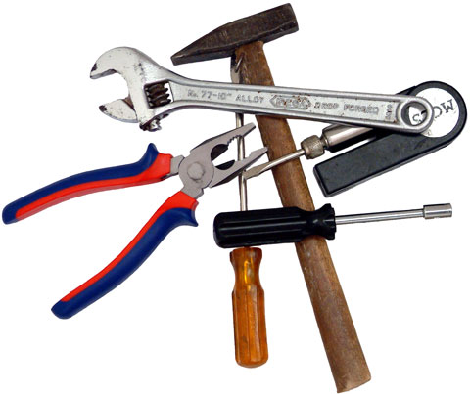
What can computers do?
Compare and manipulate values
This is done using operators. (+, -, *, /, <, ≤, =, !=, <>, >, ≥, …)
Store values in memory
Variables hold values and have different types.
Alter the flow of execution
Loop through something a certain number of times.
for loops, while loops
Split the program into paths and control what happens when.
if…else if…else statements, try…catch…finally statements
Define and run functions
Almost always followed by (brackets).

Slide 9

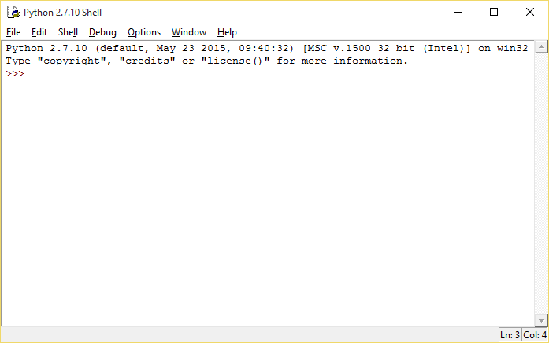
First Steps
Open IDLE (Python GUI)
IDLE stands for Integrated DeveLopment Environment

Slide 10
print(“Hello, World!”)
Traditionally, the first program written in a new language outputs “Hello, World!” to the screen. So let’s do that.
print(“Hello, World!”)
Questions:
What did that do?
What can we learn from it?
What else can we print()?

Slide 11
print(“Hello, World!”)
Questions:
What did that do?
Reading right to left:
Set up a string parameter of “Hello, World!”
Passed it to a function called ‘print’
Output the string to the screen

Slide 12
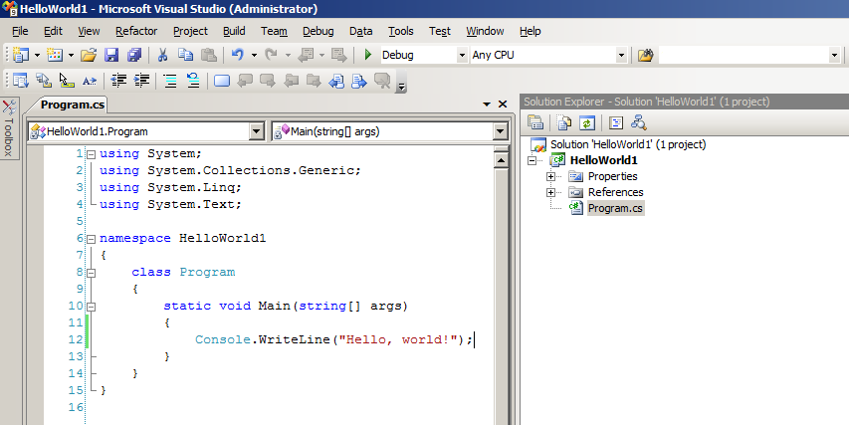
print(“Hello, World!”)
Questions:
What can we learn from it?
1) Python doesn’t need additional setup.
The equivalent “Hello, World!” in C# is →
2) The output function is print()
3) Functions can be spotted by their (brackets)
4) We can give functions extra information (parameters) in their brackets
5) Written text needs quotation marks around it

Slide 13
Hidden or visible?
Some lines of code show you something.
These are expressions.
Could be a value or the result of a calculation.
The value that comes out is called a ‘return value’.
print() returns text, which means it is an expression.
Other pieces of code just run without showing you anything.
These are statements.
They usually do something useful, but do not need to be shown to the user.

Slide 14
Hidden or visible?
Expressions return a value.
Enter these:
“Drew”
120
120 / 60
15 < 35
min(51, 79, 23, 18, 37)
Try your own!
Statements do not.
Enter these:
name = “Drew”
seconds = 120
minutes = seconds / 60
from time import sleep
sleep(1)
Try your own!

Slide 15
What else can you print()?
'Hello, World!’ (single quotes)
17 → integer
3.2 → float
‘17’ → string
‘3.2’ → string
1000000 → int
1,000,000 ← Commas are special

Slide 16
Data Types
30 years ago computers had to be told exact data types, including:
Boolean True or false
Float Floating point (decimal) numbers
Double Double-precision floating-point numbers
Integer Whole numbers (no decimal places)
Long Very big whole numbers
Char Single characters (either from a keyboard or special characters)
String One or more characters put together
DateTime Year, month, day, hour, minutes, seconds, milliseconds (+ zone)

Slide 17
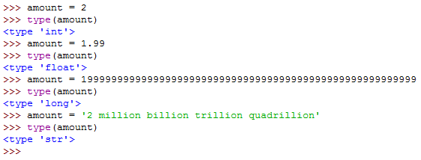
Data Types
Python works out the types for you.

Slide 18
Data Types
We can find out how values are treated using the ‘type’ function.
type(“Hello, World!”)
type(‘Hello, World!’)
type(17)
type(3.2)
type('17')
type('3.2')
type(1000000)
type(1,000,000) ← This will cause an error because commas are special
type((1,000,000))

Slide 19
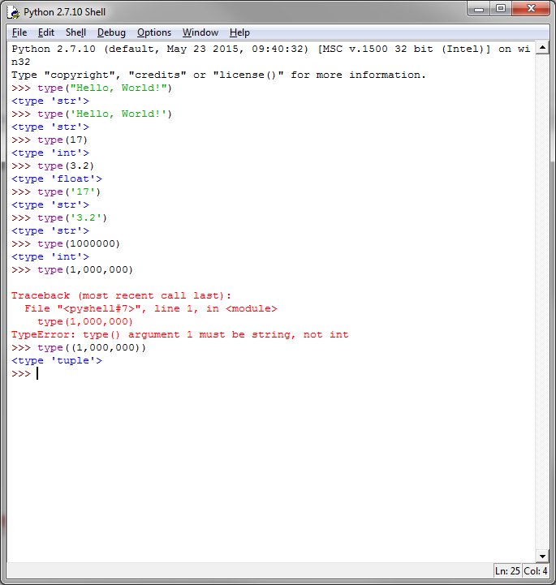
Data Types
We can find out how values are treated using the ‘type’ function.
type(“Hello, World!”)
type(‘Hello, World!’)
type(17)
type(3.2)
type('17')
type('3.2')
type(1000000)
type(1,000,000) ← Commas are special
type((1,000,000))

Slide 20
Putting It All Together
Just as numbers can be added together to form bigger numbers, strings can be added to each other to form bigger strings. (This is called concatenation.)
print(“Hello ” + “CodeUp” + “ people”)
name = “Drew”
print(“Hello ” + name)
Remember the spaces – the computer won’t do it for you!

Slide 21
Putting It All Together
Be aware of types when concatenating.
Non-strings must be converted first…
four = 4
sFour = str(four)
print(“Most dogs have ” + four + “ legs.”)
…though the conversion can be done ‘in-line’.
print(“Most dogs have ” + sFour + “ legs.”)
print(“Most dogs have ” + str(four) + “ legs.”)

Slide 22
Summary
You have used Python
You wrote your first program! Congratulations!
How computers think
Natural vs formal language
Expressions vs statements
Data types
Functions
Parameters, return values, (signatures!)

Slide 23
Questions?

Slide 24
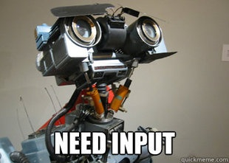
Input
So, if print() can get things out of our program…
…how do we get stuff in?

Slide 25
Input
So, if print() can get things out of our program…
…how do we get stuff in?
Keyboard
Mouse
Files
Internet

Slide 26
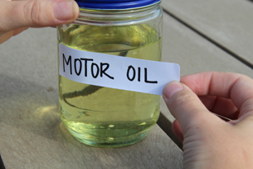
Input
Data coming into the program needs to be stored immediately, otherwise the computer loses track of it.
For this we use variables.
They hold data in memory so we can access it later.
They have types (int, float, string, etc.)
They have a name.
Names can’t start with a number or a symbol.

Slide 27
Input
There are two ways of getting data from the user. The first is as raw data.
Raw data is pure, unprocessed text (i.e. string data)
Try it:
name = raw_input(“What is your name? ”)
print(name)
type(name)
Questions:
What did that do?
What can we learn from it?

Slide 28
name = raw_input(“What is your name? ”)
Questions:
What did that do?
Reading right to left:
Set up a string parameter of “What is your name? ”
Sent it to a function called ‘raw_input’
Waited for the user to enter data
Assigned the new data a position in memory.
Called that area of memory ‘name’ and typed it as a string variable.

Slide 29
name = raw_input(“What is your name? ”)
Questions:
What can we learn from it?
Reading right to left:
The string parameter we pass to raw_input() is used as a prompt.
The function returns a value
We can store the returned value
‘=’ (equals) is the assignment operator
Variables do not have quotation marks around them.

Slide 30
Cooking the books
raw_input() will always return the data entered as a string.
If ‘raw’ is omitted, Python will ‘cook’ the input – work out its type.
age = input(“How old are you? ”)
print(age)
type(age)
Questions:
What did that do?
What can we learn from it?

Slide 31
age = input(“How old are you? ”)
Questions:
What did that do?
Reading right to left:
Set up a string parameter of “How old are you? ”
Sent it to a function called ‘input’
Waited for input
Assigned it a position in memory
Worked out what type of value had been entered
Called that area of memory ‘age’ and typed it as an int variable.

Slide 32
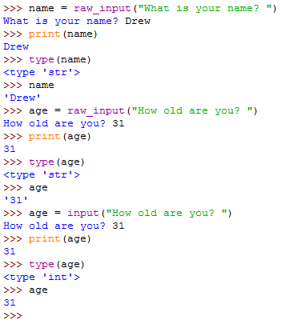
Cooking the books
The type of data stored depends on whether we use raw_input() or input().
raw_input() always gives us a string type
Even when we type in a number
input() tries to run what we enter as code
Think of it as ‘cooking’ the raw input
b = input(“true or false? ”)
type(b)

Slide 33
Different types do different things
If there are 60 seconds in a minute, what fraction of a minute is 59 seconds?
Try this:
seconds = 59
type(seconds)
seconds / 60
seconds = 59.0
type(seconds)
seconds / 60

Slide 34
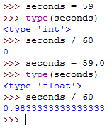
Different types do different things
Computers are fast, not clever.

Slide 35
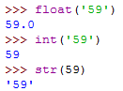
Different types do different things
Another way to get around this is by converting the value.
59 will be treated as an integer unless you tell Python different.
float(), int() and str() can all be used to change the type of a value.

Slide 36
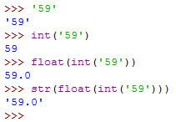
Nested functions
Because functions return values, you can use them as parameters.

Slide 37
Summary
You have used functions
print() sends data to the screen
type() tells you the type of data
raw_input() gets data from the user (as a string)
input() gets data and treats it as code, working out the type automatically
float(), int() and str() convert values
There are many data types, used for different purposes
bool (true or false); float (decimal); integer (whole number); string (text)
The type of data affects how the computer processes it

Slide 38
Questions?

Slide 39
Quick Challenge 1
Ask the user for a:
name – store it to a string variable
“he” or “she” – store it to a string variable
age – store it to an int variable
home town – string
nice colour – string
odd colour – string
number – int/float
activity – string
motto – string
Use the variables to make a story.
Operators: =, +
Functions: raw_input(), input(), print()

Slide 40
Quick Challenge 1 - Example
I have an amazing friend called Elena.
Originally from Prague, and 23 years old, Elena is pretty odd.
She has brilliant green eyes, electric pink hair and 27 fingers, and doesn’t stop playing the tuba all day every day.
The main reason I like Elena though, is a philosophy she taught me:
“Always throw in an extra spoon of jam”.

Slide 41
Quick Challenge 1
Ask the user for a:
name – store it to a string variable
“he” or “she” – store it to a string variable
age – store it to an int variable
home town – string
nice colour – string
odd colour – string
number – int/float
activity – string
motto – string
Use the variables to make a story.
Operators: =, +
Functions: raw_input(), input(), print()

Slide 42
Quick Challenge 1
name = raw_input(“Think of a name. Any name. ”)
gender = input(“Is that a ‘he’ or a ‘she’? ”)
age = input(“How old is this character? ”)
. . .
print(“I have an amazing friend called ” + name + “.”)
print(“Originally from ” + place + “, and ” + age… )

Slide 43
Well Done!
Thank you for coming. I hope you enjoyed yourself.
If you want to try some more:
These slides will be made available online
There is a book: “Think Python – How to Think Like a Computer Scientist”
Free from http://www.greenteapress.com/thinkpython/thinkpython.pdf
You can learn for free on Code Academy
They do lots of courses, including one on Python

Slide 44
Bye bye!

Slide 45
Why the error? I always put commas in numbers.
When calling a function, multiple parameters are separated by commas.
Some functions do different things depending how many parameters they get.
By passing three, ‘type()’ got confused.
Python can create new types by calling type()with 3 parameters:
A name (as a string)
An existing type to build on (as a type)
A collection of internal values (as a dictionary)
This is what it thought we were doing, so it told us to pass a string first.

Slide 46
Data Types
ASCII characters are stored as numbers (0-255) in the computer’s memory.
We can see what number a letter is equivalent to using built-in functions.
The ordinal of a character is its number, found using:
ord(‘a’)
Numbers can be converted to their respective characters:
chr(97)

Slide 47
Special Characters
The characters with ordinals below 32 are all whitespace characters.
This means they represent how information is presented, not what.
Character 9: tab: ‘\t’ used for spacing.
Character 10: newline: ‘\n’ the line feed instruction
Character 13: carriage return: ‘\r’ returns the cursor to the
start of the line

